Slide 1

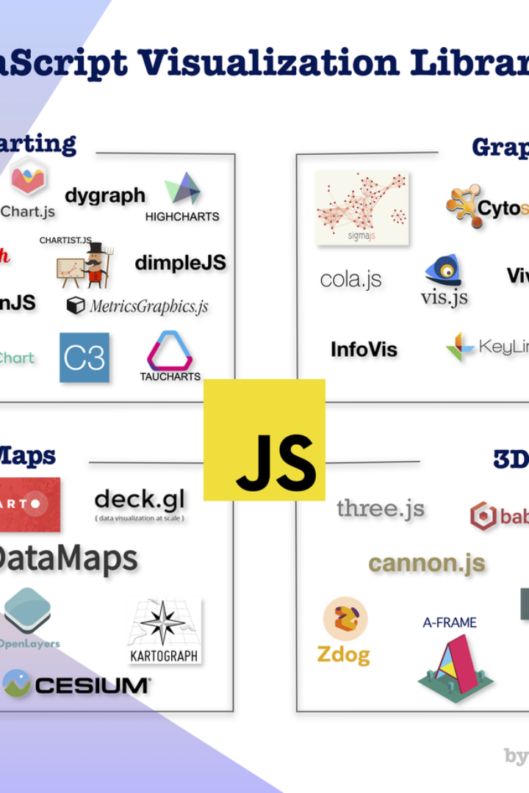


Overview of File Processing and Chart Visualization
This project involves creating a file processing and chart visualization script. The FileReader is utilized to read the contents of a file, and the script then processes the data to create dynamic visual representations.
by Priyam Raj
Bhumi Sharma

Slide 2
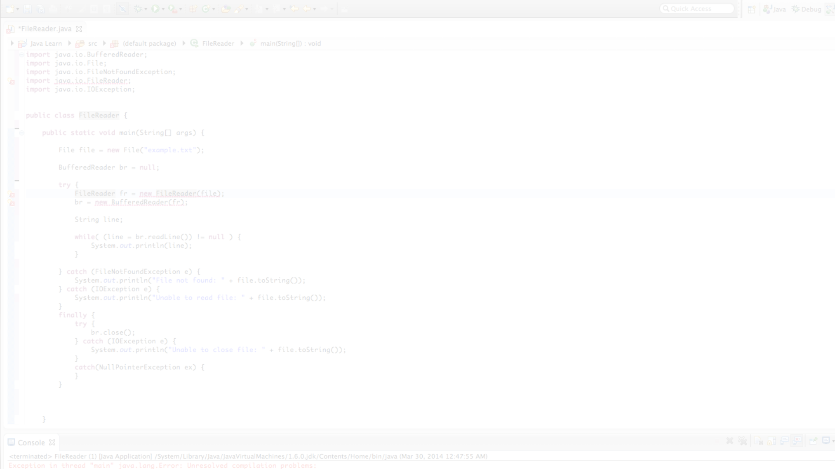
File Processing: Exploring FileReader
1
Efficient Data Access
2
Filtered summary with important questions
3
Multiple File Types
FileReader supports various file formats, allowing versatility in processing different types of data.
The FileReader API provides an efficient way to read the contents of a file, enabling seamless access to the data.
Gives important questions along with the summary of the frequently asked questions.

Slide 3
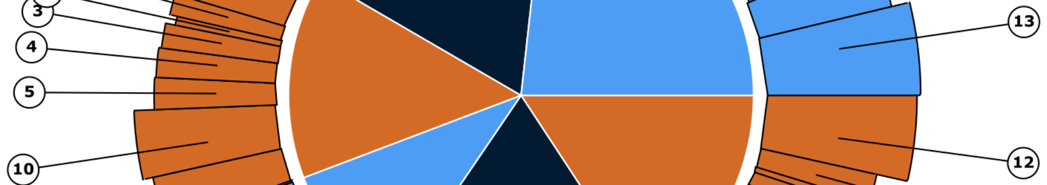
Chart Visualization: Dynamic Visual Representations
Data Insight
Customization
Interactive Display
The chart visualization script transforms complex data into insightful visual representations, allowing for better understanding and analysis.
It offers customizable options to tailor the appearance and behavior of the visualizations as per specific requirements.
Interactive features enhance user engagement by enabling dynamic exploration of the data through the visualizations.

Slide 4
Integration of File Processing and Chart Visualization
1
Data Retrieval
FileReader retrieves the necessary data from the file in various formats, ensuring compatibility with the chart visualization script.
Data Processing
2
The processed data is seamlessly integrated into the chart visualization script, generating dynamic and informative visualizations.
3
Result Display
The integrated system provides a smooth and interactive display of the visual representations, enhancing data communication and analysis.

Slide 5
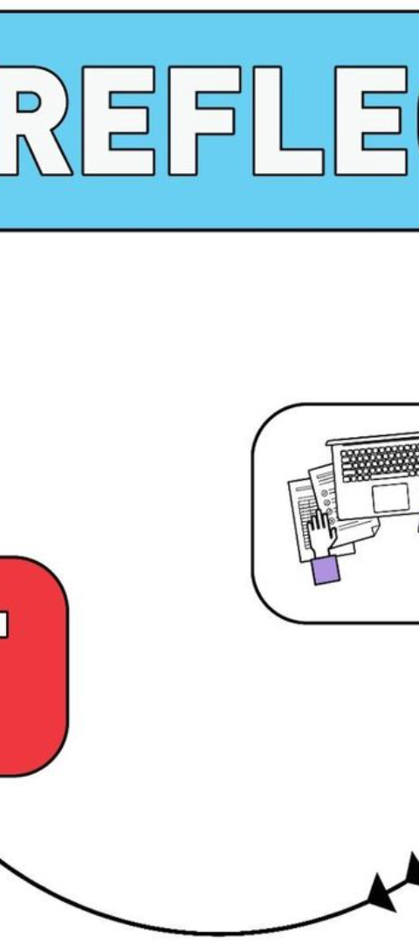
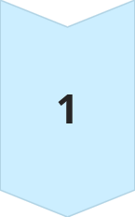
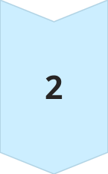
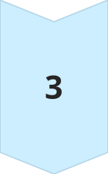
Conclusion: Summary and Next Steps
Summary
A brief overview of the accomplished work and the key highlights from the file processing and visualization tasks.
Analysis
Evaluation of the effectiveness and impact of the integrated system, along with findings and actionable insights.
Next Steps
Planning for the next phase, including potential enhancements, optimizations, and future development directions.

Slide 6
// HTML elements for file input and chart display
const fileInput = document.getElementById("file-input");
const chartCanvas = document.getElementById("chart");
// Function to process the file
function processFile() {
const file = fileInput.files[0];
const reader = new FileReader();
reader.onload = function(event) {
const text = event.target.result;
// Analyze text to identify topics and frequencies
const topicFrequencies = analyzeTopics(text);
// Generate bar chart using Chart.js
const chartData = {
labels: Object.keys(topicFrequencies).sort(),
datasets: [{
label: "Topic Frequencies",
data: Object.values(topicFrequencies),
backgroundColor: "rgba(255, 99, 132, 0.2)",
borderColor: "rgba(255, 99, 132, 1)",
borderWidth: 1
}]
};

Slide 7
const chartOptions = {
scales: {
y: {
beginAtZero: true
}
}
};
const chart = new Chart(chartCanvas, {
type: "bar",
data: chartData,
options: chartOptions
});
// TODO: Implement click event handling and question/summary display
};
reader.readAsText(file);
}

Slide 8
// Function to analyze text and extract topic frequencies
function analyzeTopics(text) {
// Implement your topic identification and counting logic here
// Example using simple word counting:
const words = text.toLowerCase().split(/\W+/);
const topicCounts = {};
words.forEach(word => {
topicCounts[word] = (topicCounts[word] || 0) + 1;
});
return topicCounts;
}
// Event listener for bar clicks
chartCanvas.onclick = function(event) {
const activePoints = chart.getElementsAtEventForMode(event, 'nearest', { intersect: true }, false);
if (activePoints.length > 0) {
const clickedIndex = activePoints[0].index;
const clickedTopic = chartData.labels[clickedIndex];
// Retrieve questions and summary for the clicked topic
const topicData = getTopicData(clickedTopic);

Slide 9
// Display the retrieved information
// (using appropriate HTML elements and styling)
const questionSummaryContainer = document.getElementById("question-summary");
questionSummaryContainer.innerHTML = `
<h2>Questions for ${clickedTopic}</h2>
<ul>
${topicData.questions.map(question => `<li>${question}</li>`).join("")}
</ul>
<p>Summary: ${topicData.summary}</p>
`;
}
};
// Function to retrieve questions and summary for a given topic
function getTopicData(topic) {
// Implement your logic to fetch topic data from source file or storage
// Example using a simple data structure:
const topicData = {
// Replace with actual questions and summary for each topic
"topic1": {
questions: ["Question 1 for topic 1", "Question 2 for topic 1"],
summary: "Summary for topic 1"
},
"topic2": {
questions: ["Questions for topic 2"],
summary: "Summary for topic 2"
},
// ...
};
return topicData[topic];
}

Slide 10


